Slide 1
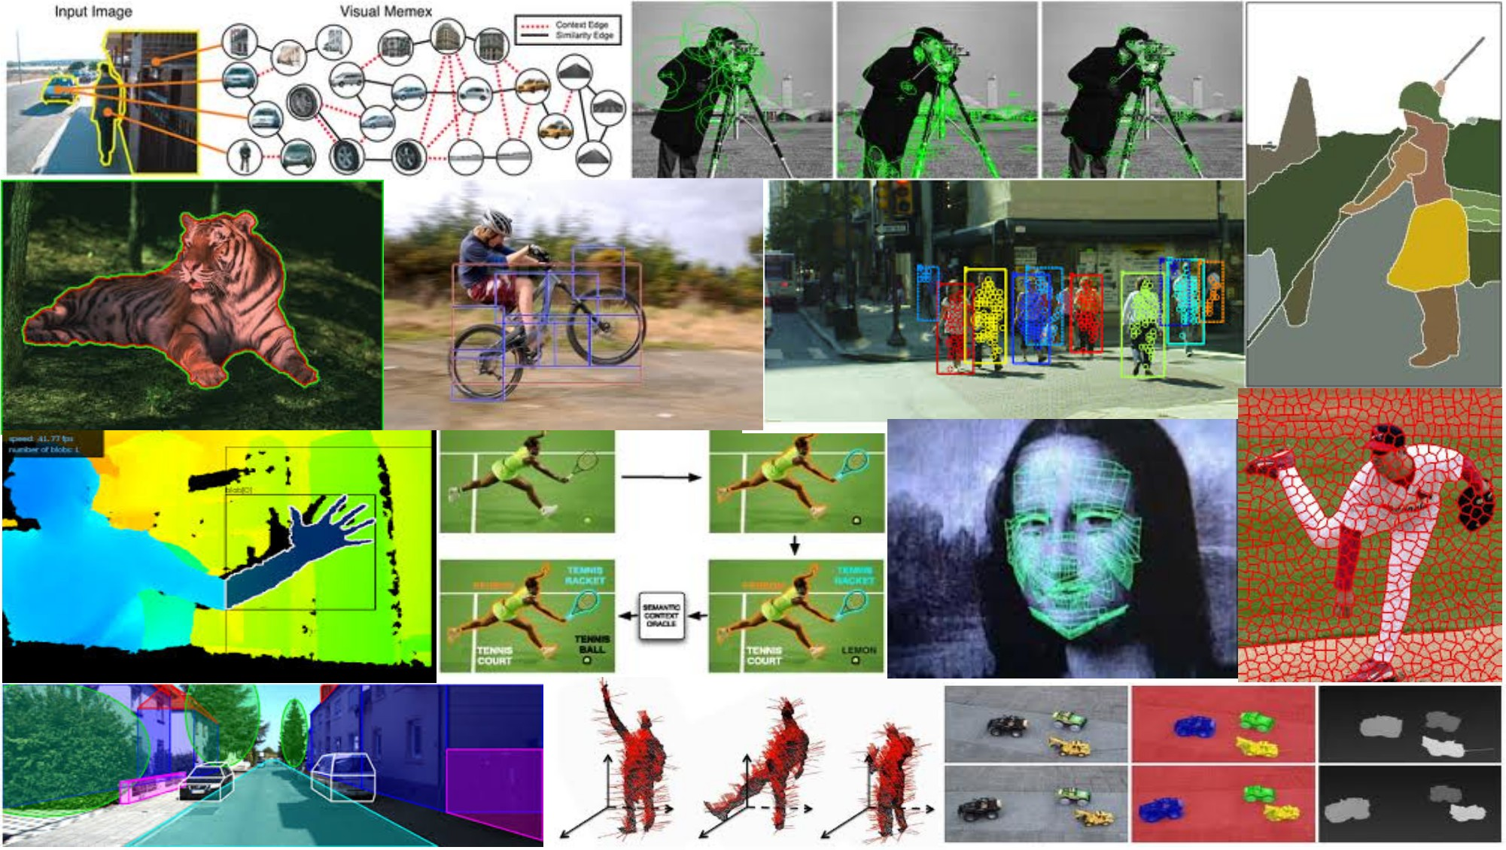
Texture April 17th, 2018
Yong Jae Lee
UC Davis

Slide 2
Announcements
PS1 out today
Due 5/2nd, 11:59 pm
start early!

Slide 3
Review: last time
Edge detection:
Filter for gradient
Threshold gradient magnitude, thin
Chamfer matching to compare shapes (in terms of edge points)
Binary image analysis
Thresholding
Morphological operators to “clean up”

Slide 4
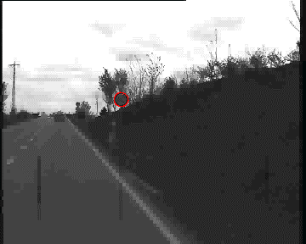
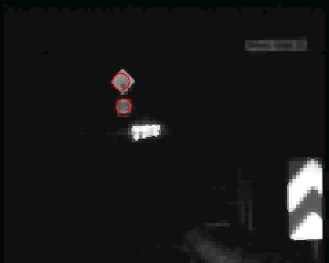
Chamfer matching system
Gavrila et al. http://gavrila.net/Research/Chamfer_System/chamfer_system.html
Slide credit: Kristen Grauman

Slide 5
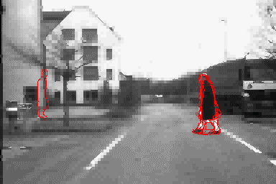
Chamfer matching system
Gavrila et al. http://gavrila.net/Research/Chamfer_System/chamfer_system.html
Slide credit: Kristen Grauman

Slide 6

ShadowDraw [Lee et al., SIGGRAPH 2011]
video

Slide 7
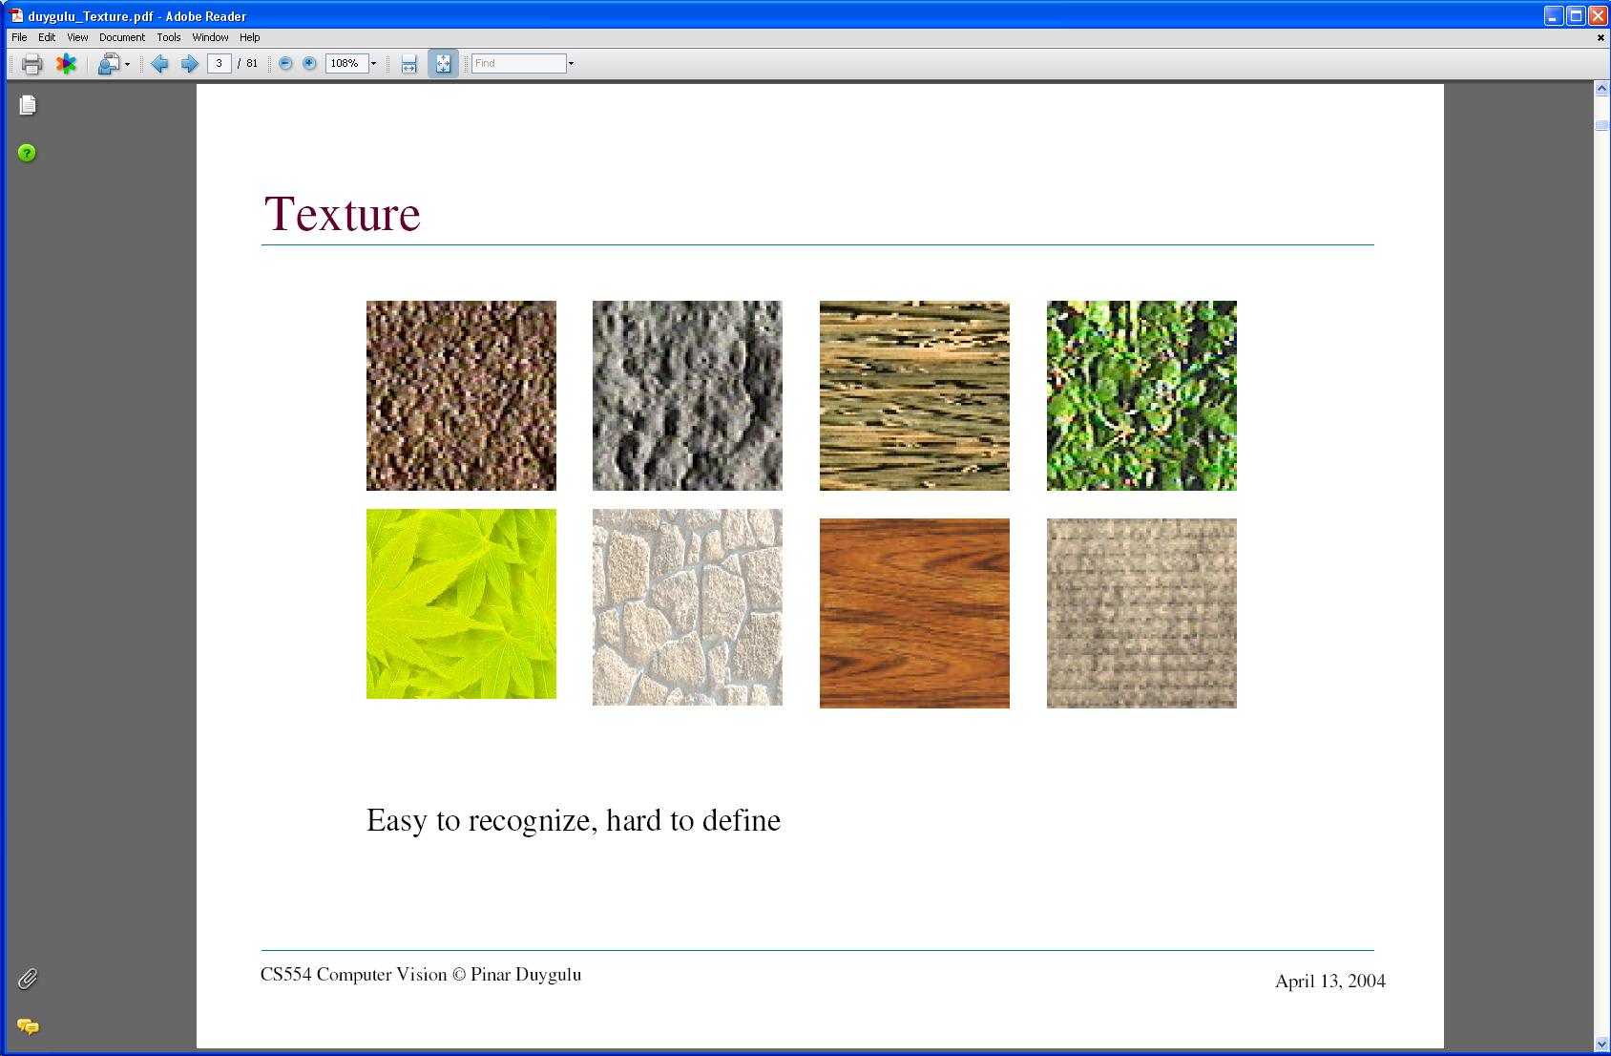
Today: Texture
What defines a texture?
Notes:
Texture is a phenomenon that is widespread, easy to recognize and hard to define.
views of large numbers of small objects are often best thought of as textures: grass, foliage, brush, pebbles and hair
many surfaces are marked with orderly patterns that look like large numbers of small objects: the spots of animals like leopards or cheetahs; the stripes of
animals like tigers or zebras; the patterns on bark, wood and skin.

Slide 8
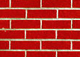

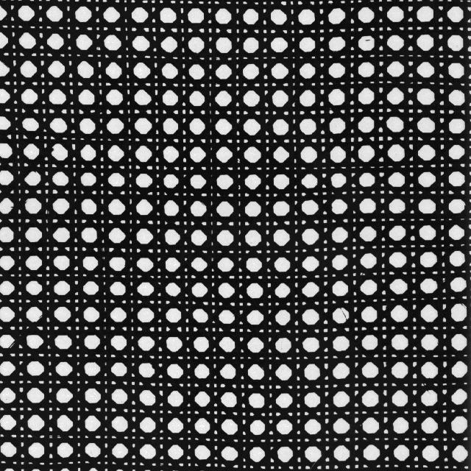
Includes: more regular patterns
Slide credit: Kristen Grauman

Slide 9
Includes: more random patterns
Slide credit: Kristen Grauman

Slide 10
Texture-related tasks
Shape from texture
Estimate surface orientation or shape from image texture
Slide credit: Kristen Grauman

Slide 11
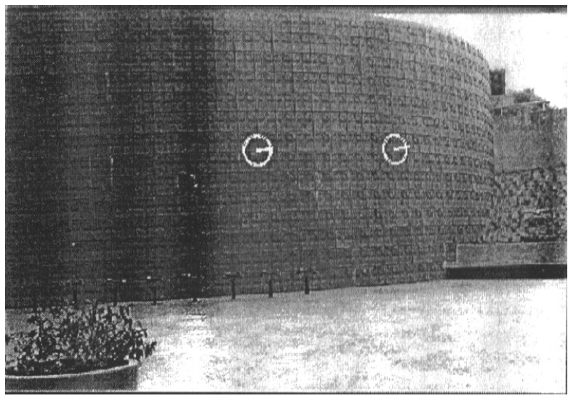
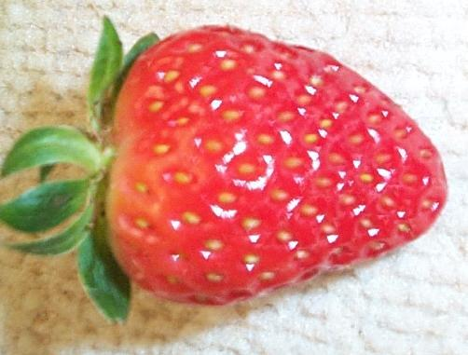
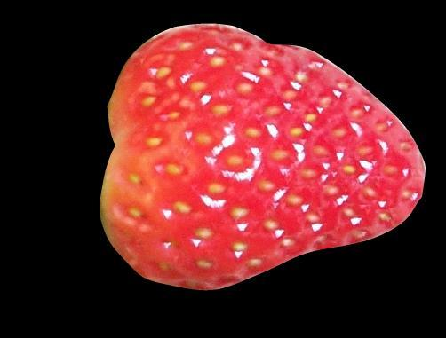
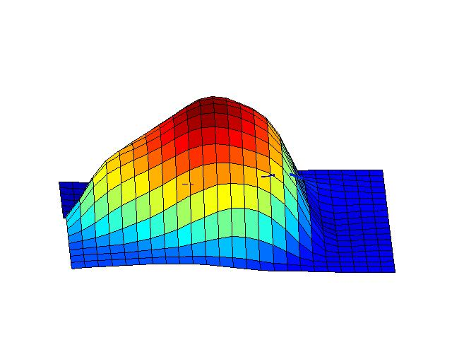
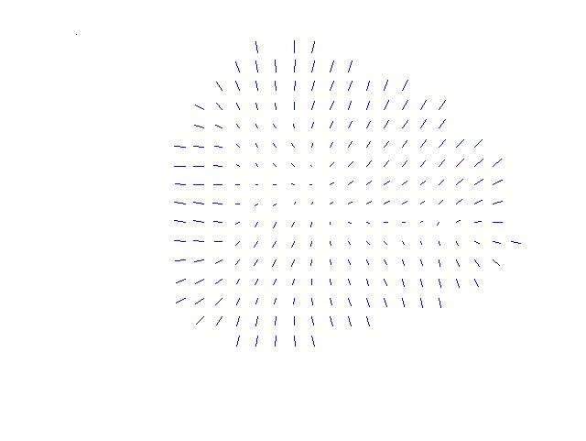
Shape from texture
Use deformation of texture from point to point to estimate surface shape
Pics from A. Loh: http://www.csse.uwa.edu.au/~angie/phdpics1.html
Slide credit: Kristen Grauman
Notes:
Assume that texture “looks the same” at different points on a surface; this means that the deformation of the texture from point to point is a cue to the shape of the surface

Slide 12
Texture-related tasks
Shape from texture
Estimate surface orientation or shape from image texture
Classification/segmentation from texture cues
Analyze, represent texture
Group image regions with consistent texture
Synthesis
Generate new texture patches/images given some examples
Slide credit: Kristen Grauman

Slide 13
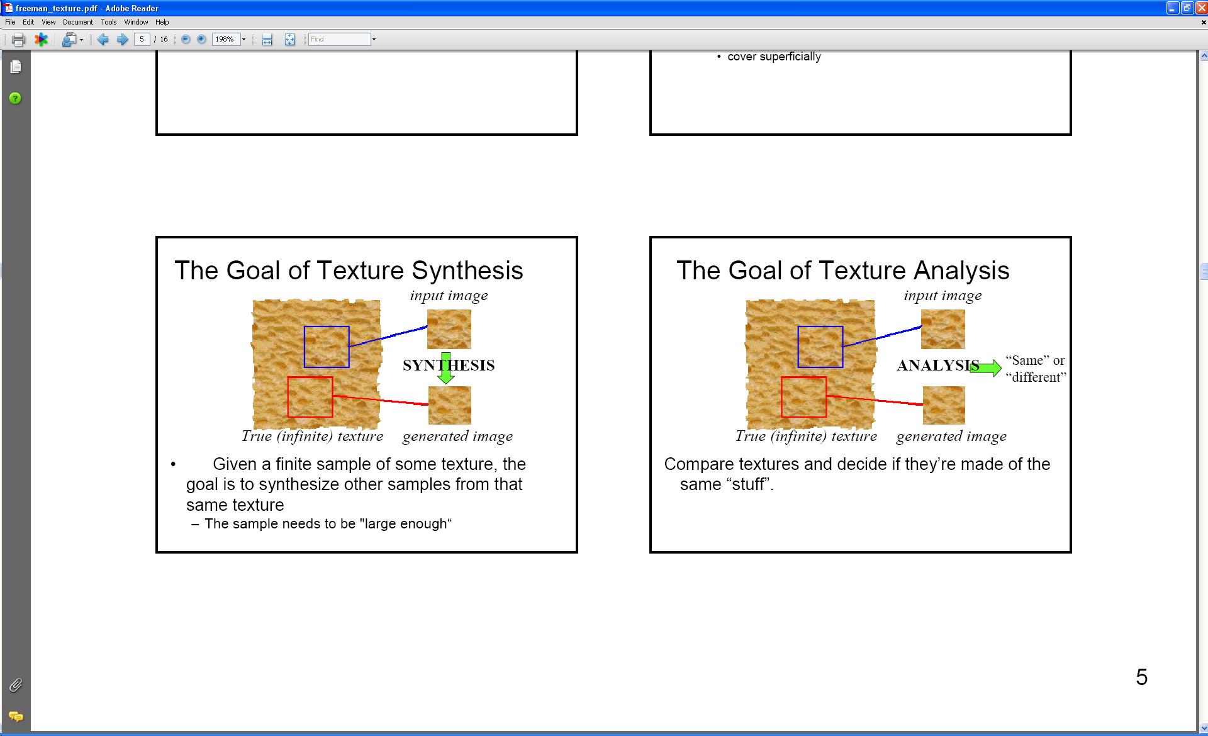
Analysis vs. Synthesis
Why analyze texture?
Images:Bill Freeman, A. Efros

Slide 14
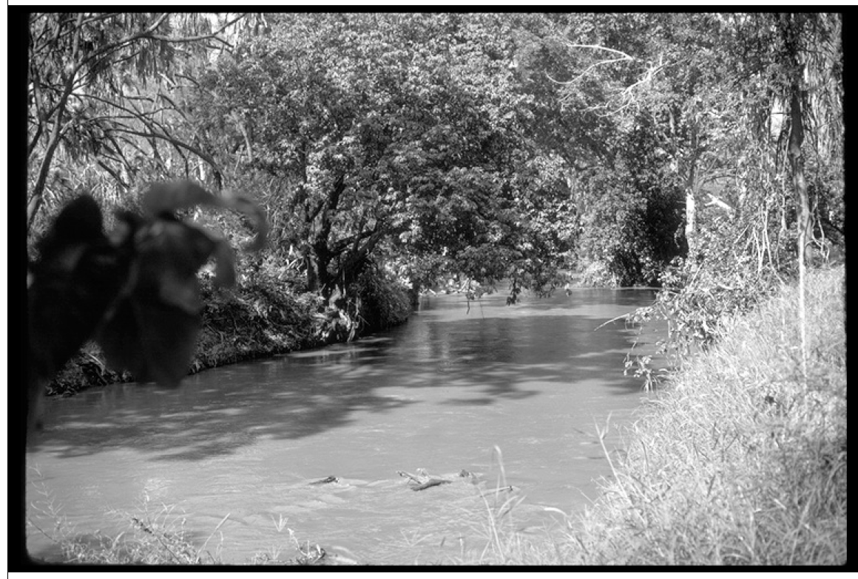
Image credit: D. Forsyth
Notes:
Material recognition.
Segmentation.

Slide 15
Why analyze texture?
Importance to perception:
Often indicative of a material’s properties
Slide credit: Kristen Grauman

Slide 16
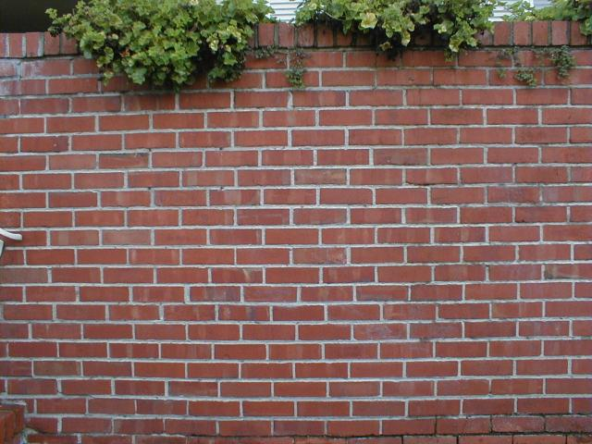
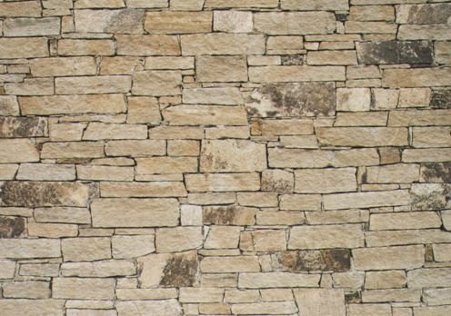
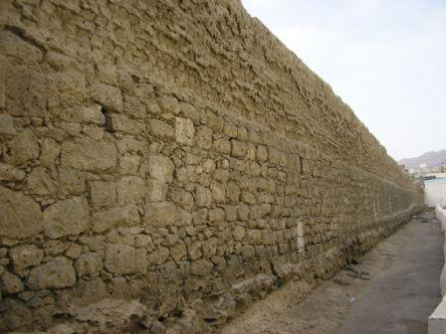
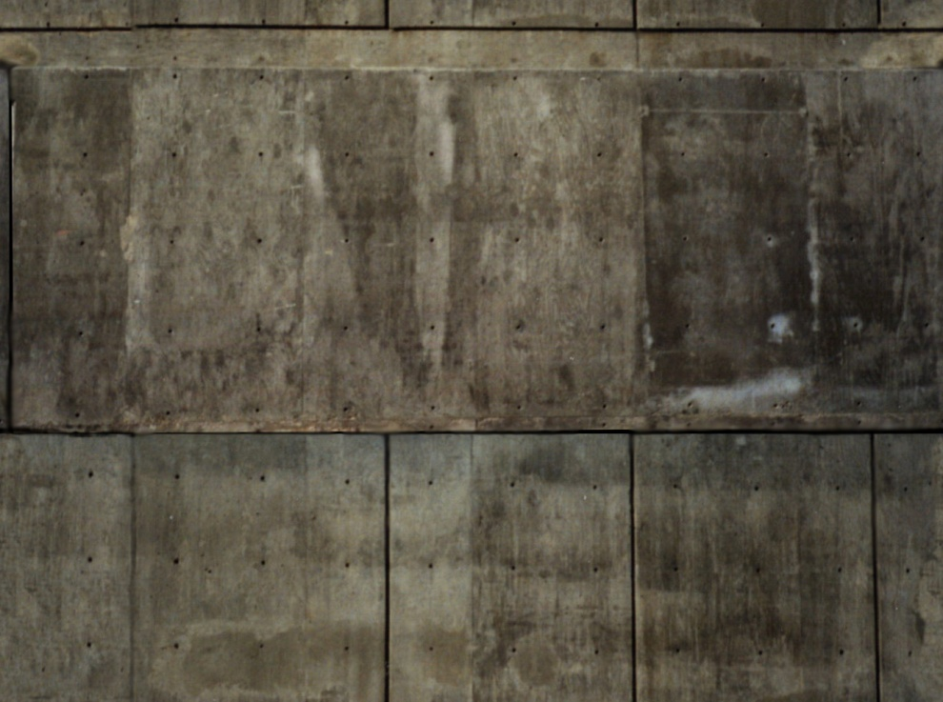
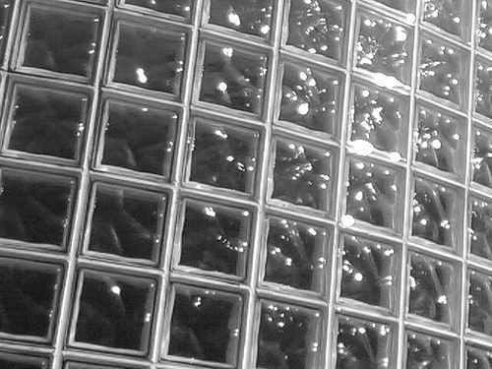
Notes:
Texture is indicative of material

Slide 17
Why analyze texture?
Importance to perception:
Often indicative of a material’s properties
Can be important appearance cue, especially if shape is similar across objects
Slide credit: Kristen Grauman

Slide 18
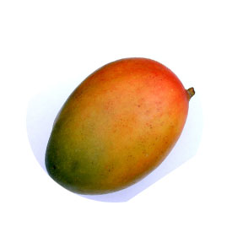
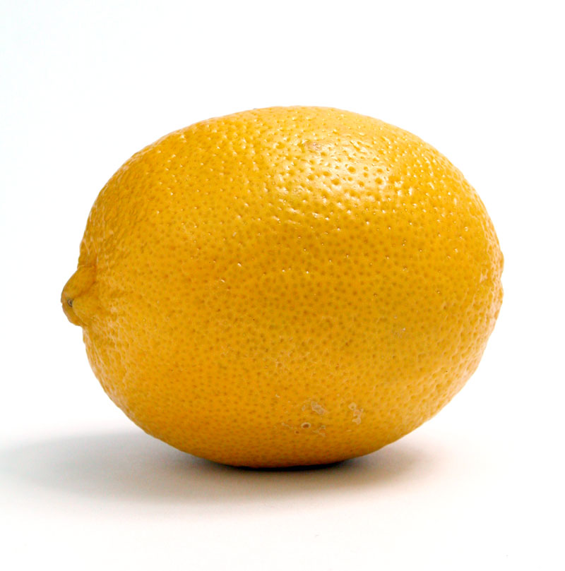
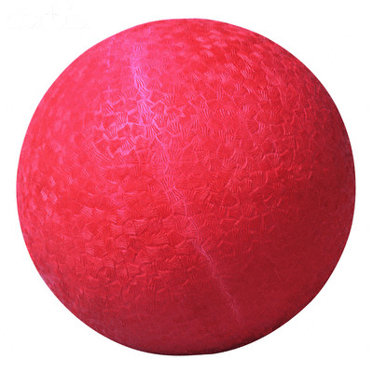
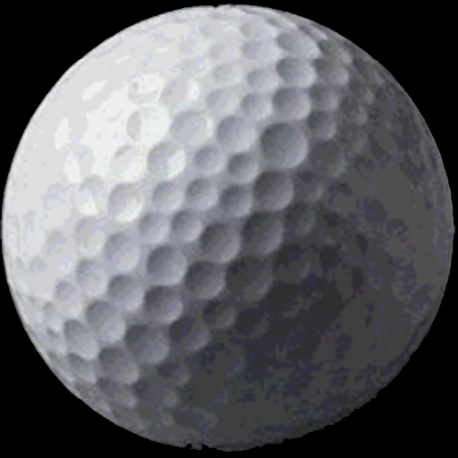
Slide credit: Kristen Grauman
Notes:
Texture is indicative of object type, especially when shape information is not useful

Slide 19
Why analyze texture?
Importance to perception:
Often indicative of a material’s properties
Can be important appearance cue, especially if shape is similar across objects
Aim to distinguish between boundaries and texture
Slide credit: Kristen Grauman

Slide 20
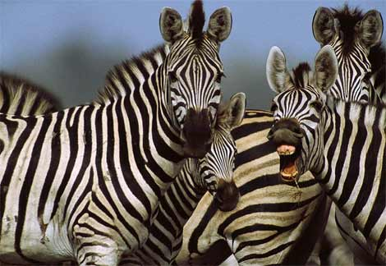
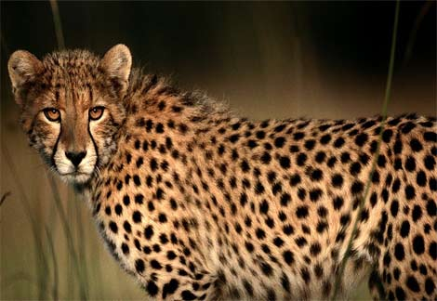
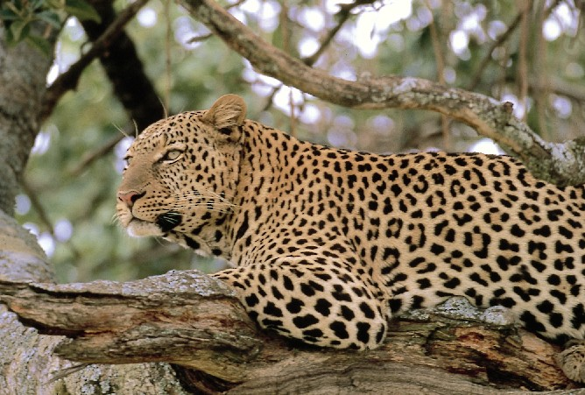
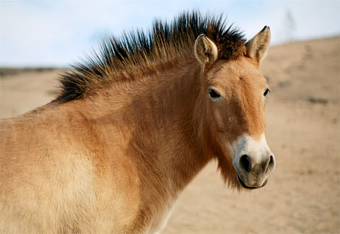
Slide credit: Kristen Grauman
http://animals.nationalgeographic.com/
Notes:
Texture can help reveal object boundaries

Slide 21
Why analyze texture?
Importance to perception:
Often indicative of a material’s properties
Can be important appearance cue, especially if shape is similar across objects
Aim to distinguish between boundaries and texture
Technically:
Representation-wise, we want a feature one step above “building blocks” of filters, edges.
Slide credit: Kristen Grauman

Slide 22
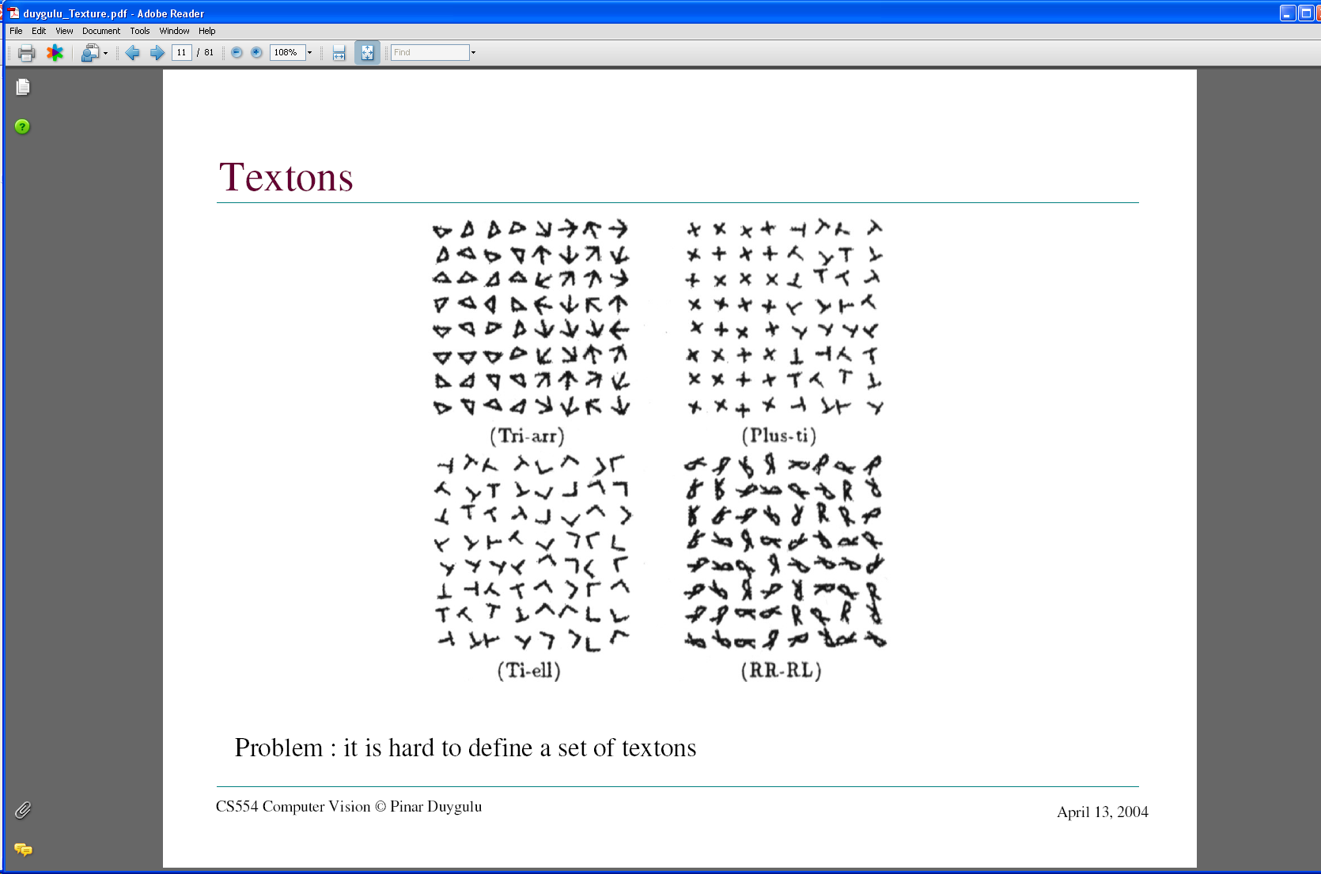
Images from Malik and Perona, 1990

Slide 23
Psychophysics of texture
Some textures distinguishable with preattentive perception – without scrutiny, eye movements [Julesz 1975]
Same or different?
Slide credit: Kristen Grauman
Notes:
psychophysics: the branch of psychology that deals with the relationships between physical stimuli and mental phenomena.

Slide 24
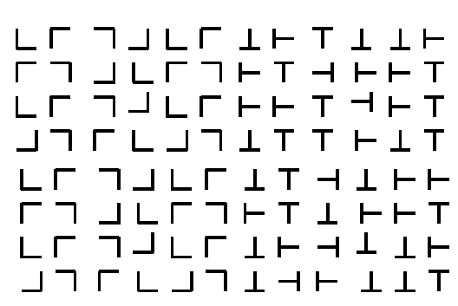

Slide 25
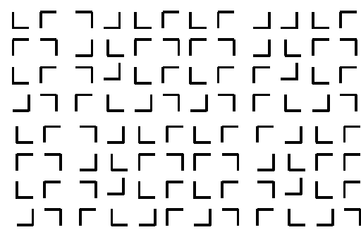

Slide 27
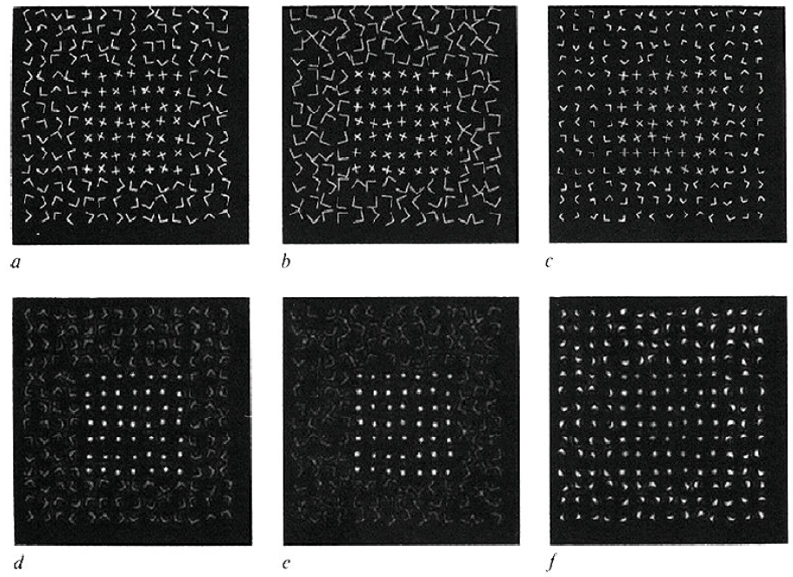
Capturing the local patterns with image measurements
[Bergen & Adelson, Nature 1988]
Scale of patterns influences discriminability
Size-tuned linear filters
Notes:
texture discriminability can depend on scale

Slide 28
Texture representation
Textures are made up of repeated local patterns, so:
Find the patterns
Use filters that look like patterns (spots, bars, raw patches…)
Consider magnitude of response
Describe their statistics within each local window
Mean, standard deviation
Histogram of “prototypical” feature occurrences
Slide credit: Kristen Grauman
Notes:
Instead of looking for patterns at the level of arrowheads and triangles, we could look for even simpler pattern elements — dots and bars, say — and then reason about their spatial layout.
The advantage of this approach is that it is easy to look for simple pattern elements by filtering an image

Slide 29
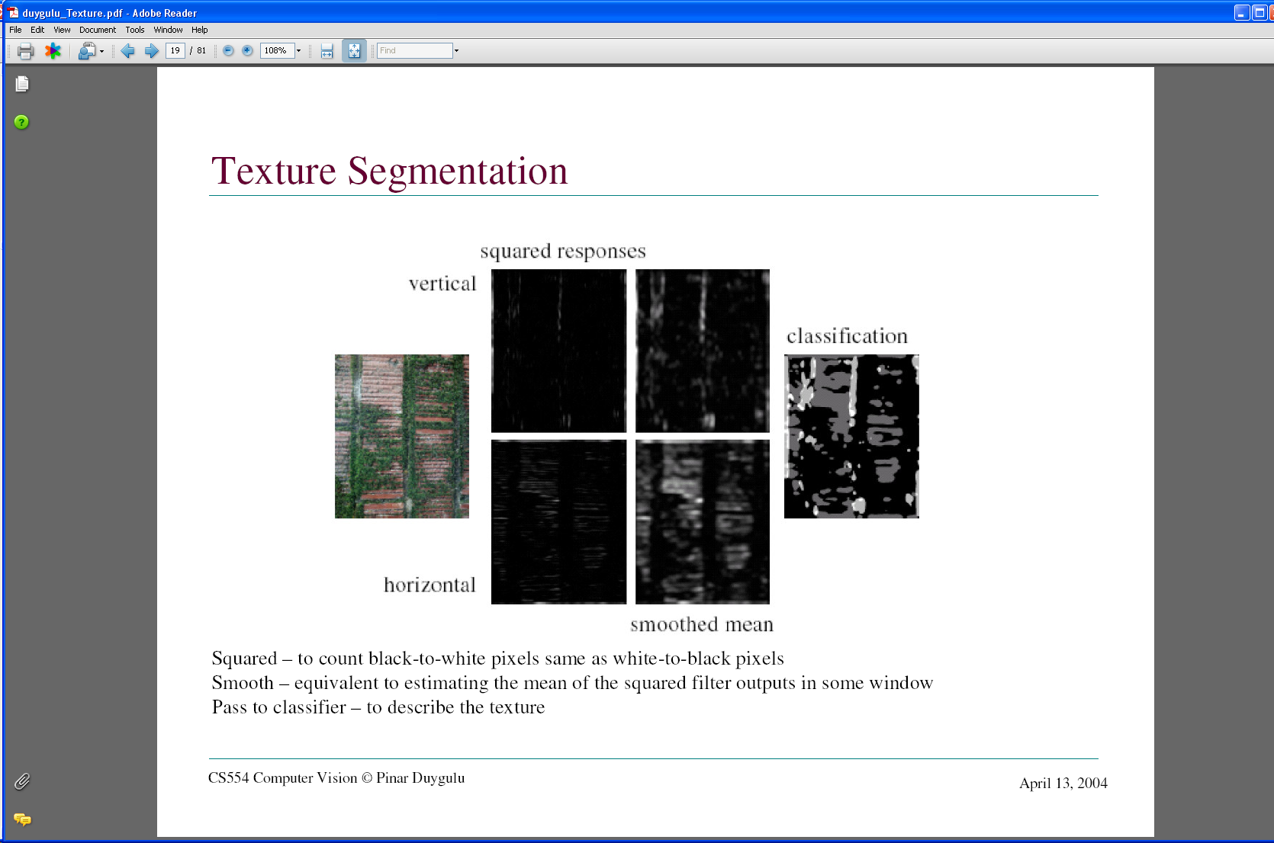
Texture representation: example
 | mean d/dx value | mean d/dy value
Win. #1 | 4 | 10
original image
…
statistics to summarize patterns in small windows
derivative filter responses, squared
Slide credit: Kristen Grauman

Slide 30
Texture representation: example
 | mean d/dx value | mean d/dy value
Win. #1 | 4 | 10
Win.#2 | 18 | 7
original image
…
statistics to summarize patterns in small windows
derivative filter responses, squared
Slide credit: Kristen Grauman

Slide 31
Texture representation: example
 | mean d/dx value | mean d/dy value
Win. #1 | 4 | 10
Win.#2 | 18 | 7
Win.#9 | 20 | 20
original image
…
…
statistics to summarize patterns in small windows
derivative filter responses, squared
Slide credit: Kristen Grauman

Slide 32
Texture representation: example
 | mean d/dx value | mean d/dy value
Win. #1 | 4 | 10
Win.#2 | 18 | 7
Win.#9 | 20 | 20
Dimension 2 (mean d/dy value)
Dimension 1 (mean d/dx value)
…
…
statistics to summarize patterns in small windows
Slide credit: Kristen Grauman

Slide 33
Texture representation: example
Windows with primarily horizontal edges
Both
 | mean d/dx value | mean d/dy value
Win. #1 | 4 | 10
Win.#2 | 18 | 7
Win.#9 | 20 | 20
Dimension 2 (mean d/dy value)
Dimension 1 (mean d/dx value)
…
…
Windows with small gradient in both directions
Windows with primarily vertical edges
statistics to summarize patterns in small windows
Slide credit: Kristen Grauman

Slide 34
Texture representation: example
original image
visualization of the assignment to texture “types”
derivative filter responses, squared
Slide credit: Kristen Grauman

Slide 35
Texture representation: example
 | mean d/dx value | mean d/dy value
Win. #1 | 4 | 10
Win.#2 | 18 | 7
Win.#9 | 20 | 20
Dimension 2 (mean d/dy value)
Far: dissimilar textures
Close: similar textures
Dimension 1 (mean d/dx value)
…
…
statistics to summarize patterns in small windows
Slide credit: Kristen Grauman

Slide 36
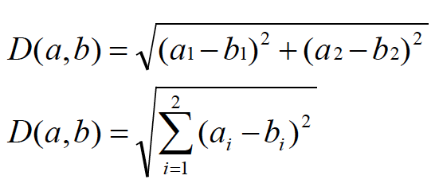
Texture representation: example
Dimension 2
Dimension 1
Slide credit: Kristen Grauman
Notes:
36

Slide 37
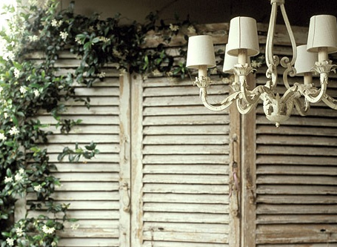
Texture representation: example
Dimension 2
Dimension 1
Distance reveals how dissimilar texture from window a is from texture in window b.
Slide credit: Kristen Grauman
Notes:
37

Slide 38
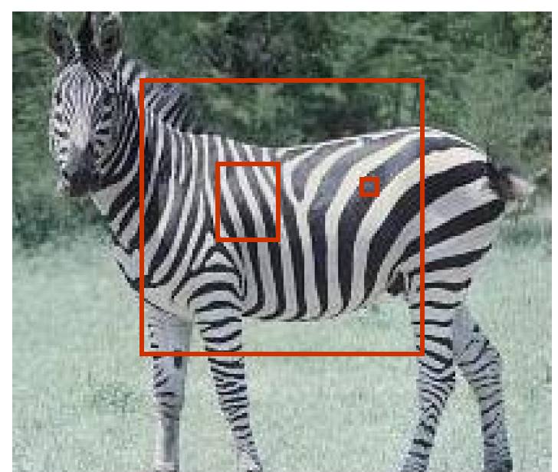
Texture representation: window scale
The window size (i.e., scale) for which we collect these statistics is important.
Possible to perform scale selection by looking for window scale where texture description not changing.
Notes:
The choice of scale is important for description

Slide 39
Filter banks
Our previous example used two filters, and resulted in a 2-dimensional feature vector to describe texture in a window
x and y derivatives revealed something about local structure
We can generalize to apply a collection of multiple (d) filters: a “filter bank”
Then our feature vectors will be d-dimensional
still can think of nearness, farness in feature space
Slide credit: Kristen Grauman

Slide 40
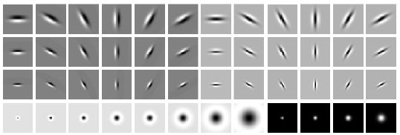
Filter banks
orientations
scales
“Edges”
“Bars”
“Spots”
What filters to put in the bank?
Typically we want a combination of scales and orientations, different types of patterns.
Matlab code available for these examples: http://www.robots.ox.ac.uk/~vgg/research/texclass/filters.html
Slide credit: Kristen Grauman
Notes:
By analogy with the human visual cortex, it is usual to use at least one spot filter and a collection of oriented bar filters at different orientations, scales and phases

Slide 41
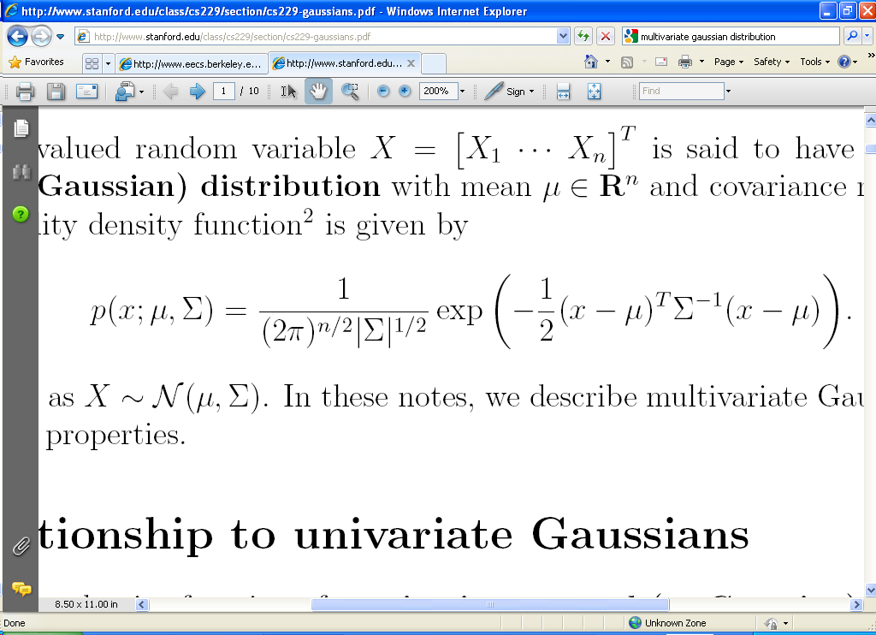
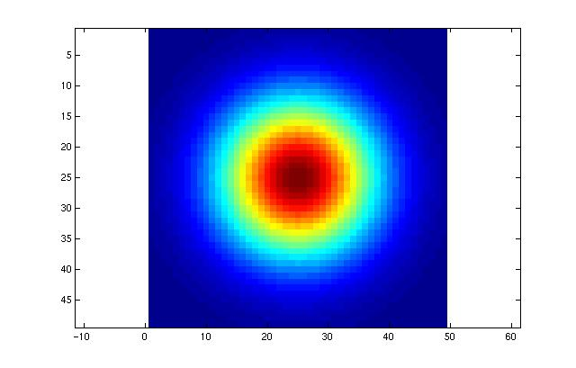
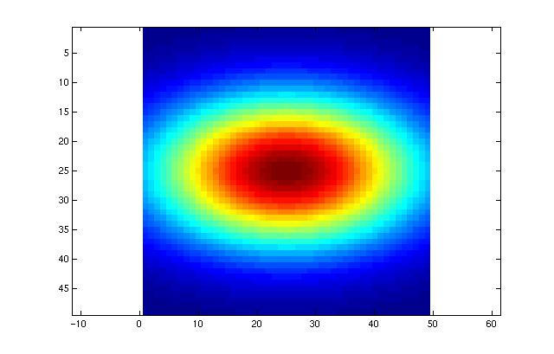
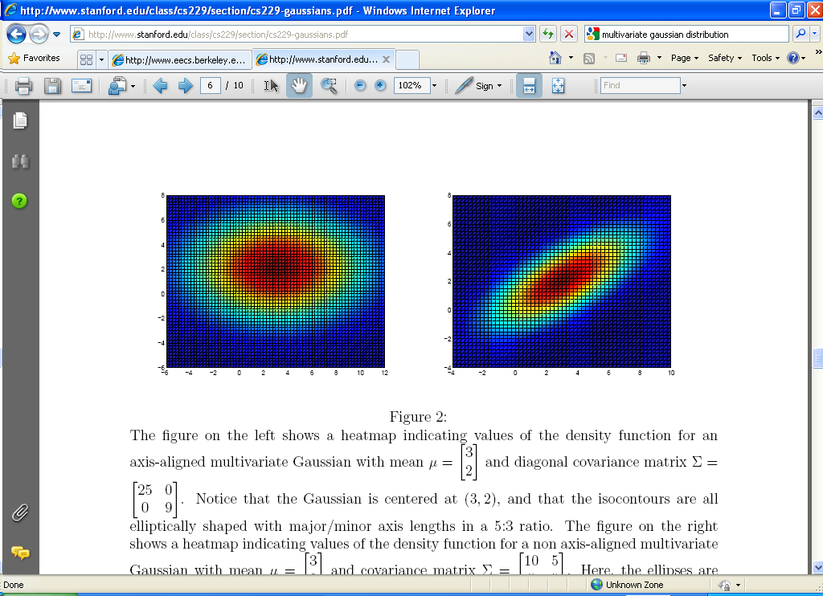
Multivariate Gaussian
Slide credit: Kristen Grauman
Notes:
Isotropic
anisotropic

Slide 42
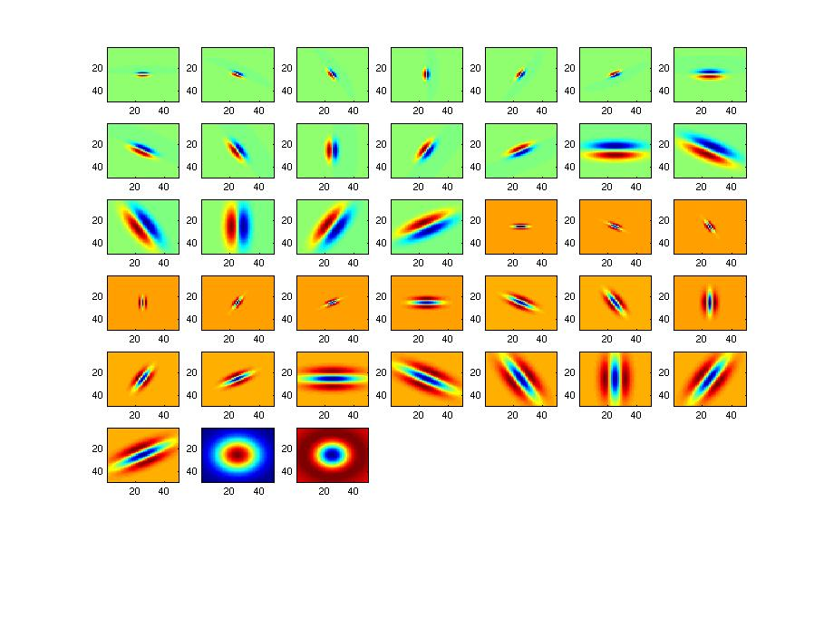
Filter bank
Slide credit: Kristen Grauman

Slide 43

Image from http://www.texasexplorer.com/austincap2.jpg
Slide credit: Kristen Grauman

Slide 44
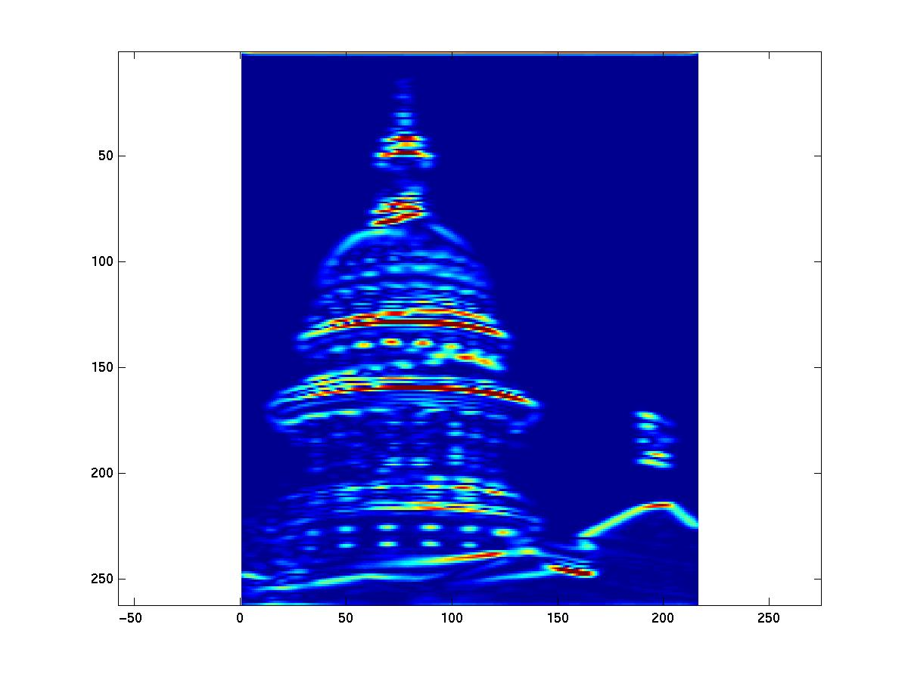
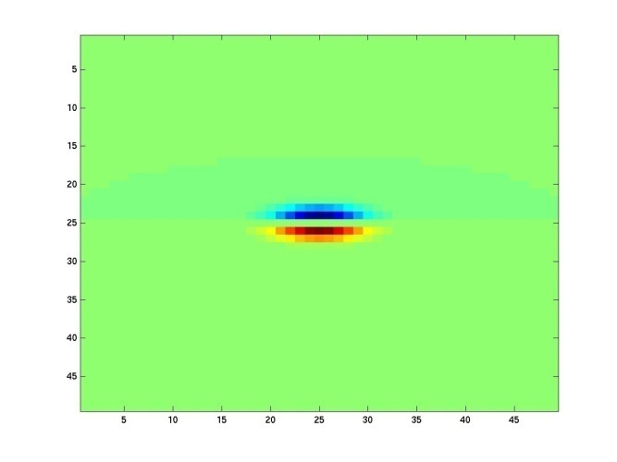
Showing magnitude of responses
Slide credit: Kristen Grauman

Slide 45
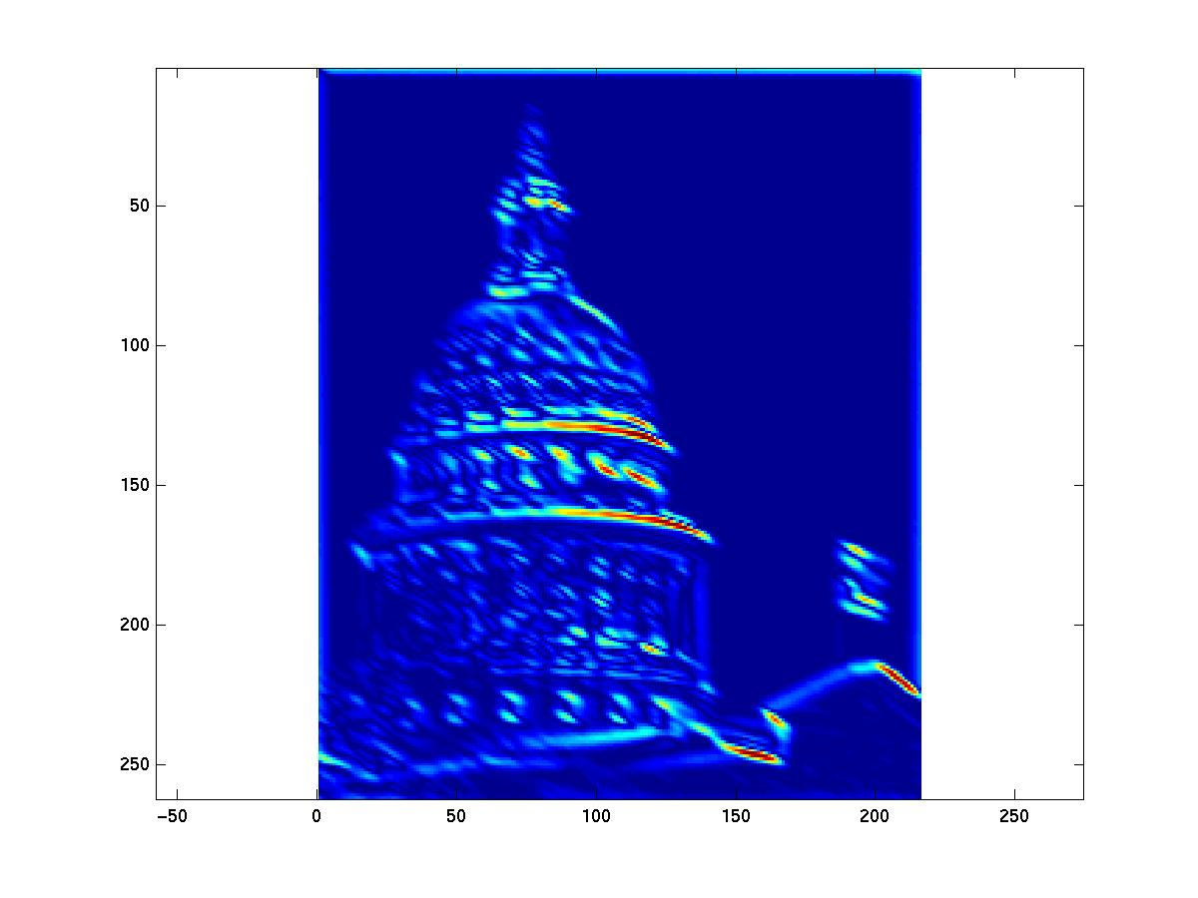
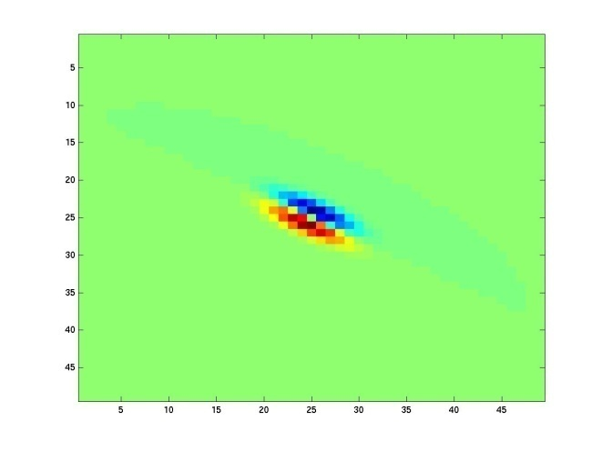
Slide credit: Kristen Grauman
Notes:
2

Slide 46
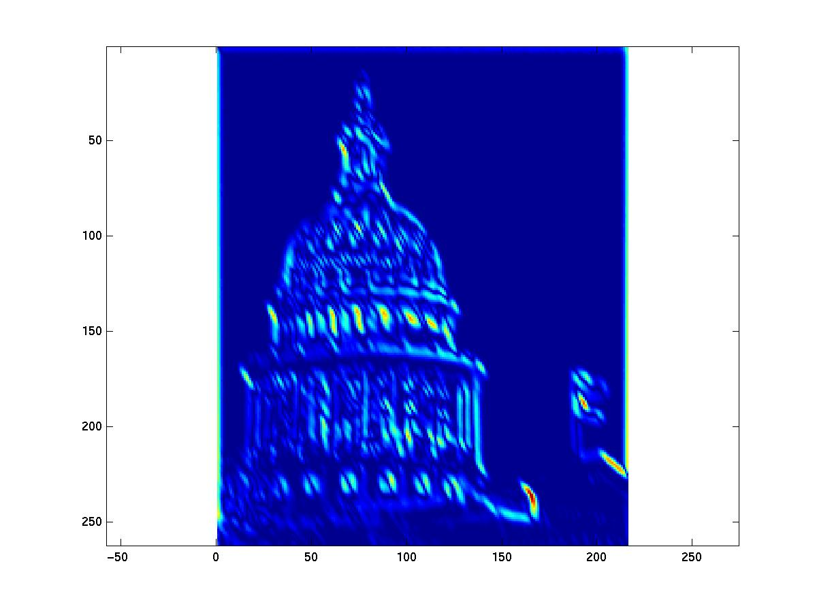
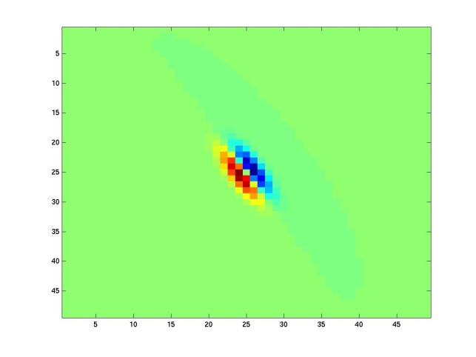
Slide credit: Kristen Grauman
Notes:
3

Slide 47
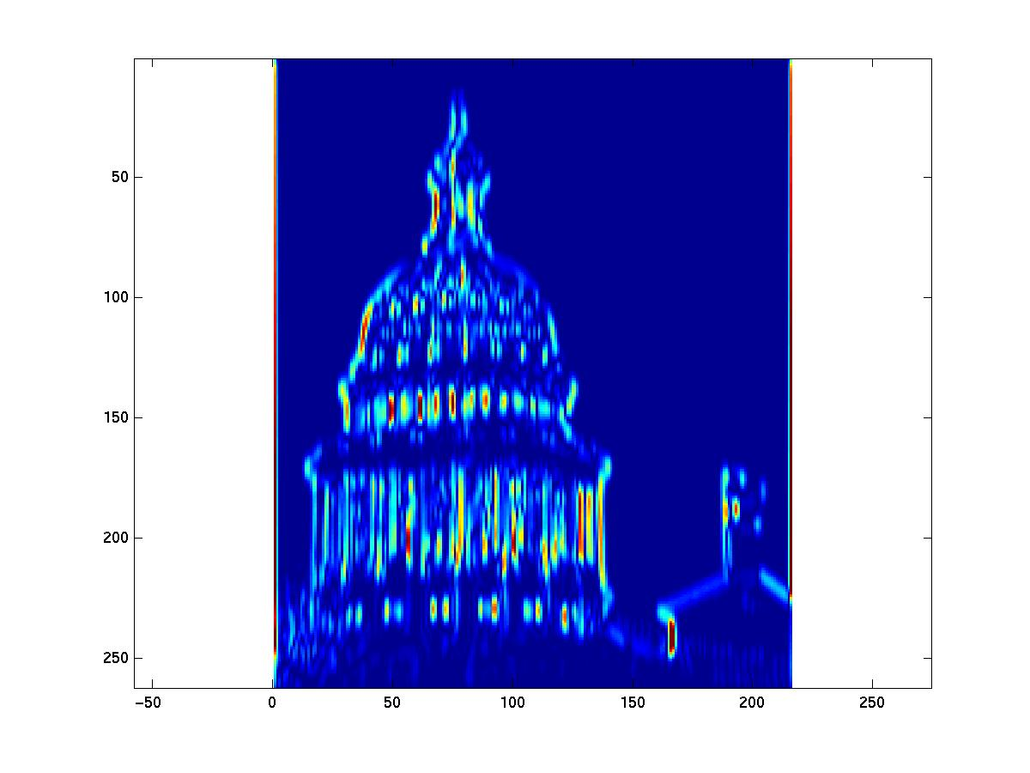
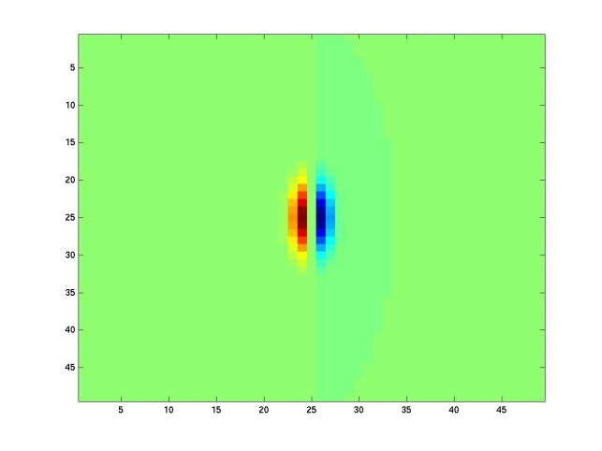
Slide credit: Kristen Grauman
Notes:
4

Slide 48
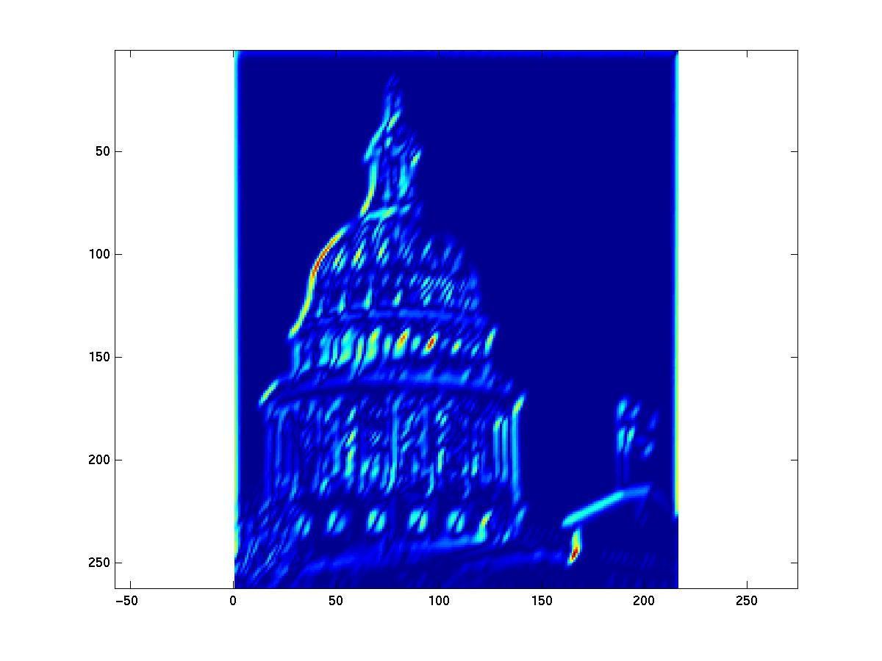

Slide credit: Kristen Grauman

Slide 49


Slide credit: Kristen Grauman
Notes:
6

Slide 50


Slide credit: Kristen Grauman
Notes:
7

Slide 51


Slide credit: Kristen Grauman
Notes:
8

Slide 52


Slide credit: Kristen Grauman
Notes:
9

Slide 53


Slide credit: Kristen Grauman
Notes:
10

Slide 54


Slide credit: Kristen Grauman
Notes:
11

Slide 55


Slide credit: Kristen Grauman
Notes:
12

Slide 56


Slide credit: Kristen Grauman
Notes:
13

Slide 57


Slide credit: Kristen Grauman
Notes:
14

Slide 58


Slide credit: Kristen Grauman
Notes:
15

Slide 59


Slide credit: Kristen Grauman
Notes:
16

Slide 60


Slide credit: Kristen Grauman

Slide 61


Slide credit: Kristen Grauman
Notes:
18

Slide 62


Slide credit: Kristen Grauman

Slide 63






You try: Can you match the texture to the response?
Filters
A
B
1
2
C
3
Mean abs responses
Slide credit: Derek Hoiem

Slide 64

Representing texture by mean abs response
Filters
Slide credit: Derek Hoiem
Mean abs responses

Slide 65
[r1, r2, …, r38]
We can form a feature vector from the list of responses at each pixel.
Slide credit: Kristen Grauman

Slide 66
d-dimensional features
Euclidean distance (L₂)
. . .
2d
3d
Slide credit: Kristen Grauman

Slide 67
Example uses of texture in vision: analysis

Slide 68

Classifying materials, “stuff”
Figure by Varma & Zisserman

Slide 69

Texture features for image retrieval
Y. Rubner, C. Tomasi, and L. J. Guibas. The earth mover's distance as a metric for image retrieval. International Journal of Computer Vision, 40(2):99-121, November 2000,
Slide credit: Kristen Grauman

Slide 70


Characterizing scene categories by texture
L. W. Renninger and J. Malik. When is scene identification just texture recognition? Vision Research 44 (2004) 2301–2311
Slide credit: Kristen Grauman

Slide 71
Texture-related tasks
Shape from texture
Estimate surface orientation or shape from image texture
Segmentation/classification from texture cues
Analyze, represent texture
Group image regions with consistent texture
Synthesis
Generate new texture patches/images given some examples
Slide credit: Kristen Grauman

Slide 72
Texture synthesis
Goal: create new samples of a given texture
Many applications: virtual environments, hole-filling, texturing surfaces
Slide credit: Kristen Grauman

Slide 73


The Challenge
Need to model the whole spectrum: from repeated to stochastic texture
repeated
Alexei A. Efros and Thomas K. Leung, “Texture Synthesis by Non-parametric Sampling,” Proc. International Conference on Computer Vision (ICCV), 1999.
stochastic
Both?

Slide 74









Markov Chains
Markov Chain
a sequence of random variables
is the state of the model at time t
Markov assumption: each state is dependent only on the previous one
dependency given by a conditional probability:
The above is actually a first-order Markov chain
An N’th-order Markov chain:
Source S. Seitz
Notes:
a stochastic model describing a sequence of possible events in which the probability of each event depends only on the state attained in the previous event

Slide 75

Markov Chain Example: Text
“A dog is a man’s best friend. It’s a dog eat dog world out there.”
a
dog
is
man’s
best
friend
it’s
eat
world
p(dog|a) = ?
out
there
.
a
dog
is
it’s
eat
out
.
best
friend
there
man’s
world
Slide credit: Adapted by Devi Parikh from Steve Seitz

Slide 76
Markov Chain Example: Text
“A dog is a man’s best friend. It’s a dog eat dog world out there.”
a
 | 2/3 |  | 1/3
 |  | 1/3 |  |  |  |  | 1/3 | 1/3
1
 |  |  |  | 1
 |  |  |  |  | 1
 |  |  |  |  |  |  |  |  |  |  | 1
1
 | 1
 |  |  |  |  |  |  |  |  | 1
 |  |  |  |  |  |  |  |  |  | 1
 |  |  |  |  |  |  |  |  |  |  | 1
 |  |  |  |  |  | 1
dog
is
man’s
best
friend
it’s
eat
world
out
there
.
a
dog
is
it’s
eat
out
.
best
friend
there
man’s
world
Slide credit: Steve Seitz

Slide 77



Text synthesis
Create plausible looking poetry, love letters, term papers, etc.
Most basic algorithm
Build probability histogram/table
find all blocks of N consecutive words/letters in training documents
compute probability of occurrence
Given words
compute by sampling from
WE NEED
TO
EAT
CAKE
Slide credit: Steve Seitz

Slide 78
Text synthesis
Results:
“As I've commented before, really relating to someone involves standing next to impossible.”
"One morning I shot an elephant in my arms and kissed him.”
"I spent an interesting evening recently with a grain of salt"
Dewdney, “A potpourri of programmed prose and prosody” Scientific American, 1989.
Slide from Alyosha Efros, ICCV 1999
Notes:
Mark Shaney program read all the messages in the UseNet News group called net.single and spit back messages.

Slide 79

Markov Random Field
A Markov random field (MRF)
generalization of Markov chains to two or more dimensions.
First-order MRF:
probability that pixel X takes a certain value given the values of neighbors A, B, C, and D:
A
D
X
B
C
Slide credit: Steve Seitz

Slide 80




Texture Synthesis [Efros & Leung, ICCV 99]
Can apply 2D version of text synthesis
Texture corpus (sample)
Output
Slide from Alyosha Efros, ICCV 1999

Slide 81

Texture synthesis: intuition
Before, we inserted the next word based on existing nearby words…
Now we want to insert pixel intensities based on existing nearby pixel values.
Place we want to insert next
Sample of the texture
(“corpus”)
Distribution of a value of a pixel is conditioned on its neighbors alone.
Slide credit: Kristen Grauman

Slide 82


Synthesizing One Pixel
p
input image
synthesized image
What is ?
Find all the windows in the image that match the neighborhood
To synthesize x
pick one matching window at random
assign x to be the center pixel of that window
An exact neighbourhood match might not be present, so find the best matches using SSD error and randomly choose between them, preferring better matches with higher probability
Slide from Alyosha Efros, ICCV 1999

Slide 83




Neighborhood Window
input
Slide from Alyosha Efros, ICCV 1999

Slide 84









Varying Window Size
Increasing window size
Slide from Alyosha Efros, ICCV 1999

Slide 85



Growing Texture
Starting from the initial image, “grow” the texture one pixel at a time
Slide from Alyosha Efros, ICCV 1999

Slide 86




Synthesis results
french canvas
rafia weave
Slide from Alyosha Efros, ICCV 1999

Slide 87


Synthesis results
white bread
brick wall
Slide from Alyosha Efros, ICCV 1999

Slide 88


Synthesis results
Slide from Alyosha Efros, ICCV 1999

Slide 89




Failure Cases
Growing garbage
Verbatim copying
Slide from Alyosha Efros, ICCV 1999

Slide 90






Hole Filling
Slide from Alyosha Efros, ICCV 1999

Slide 91




Extrapolation
Slide from Alyosha Efros, ICCV 1999

Slide 92
The Efros & Leung algorithm
Simple
Surprisingly good results
Synthesis is easier than analysis!
…but very slow

Slide 93
Image Quilting [Efros & Freeman 2001]
non-parametric
sampling
p
B
Input image
Synthesizing a block
Observation: neighbor pixels are highly correlated
Idea: unit of synthesis = block
Exactly the same but now we want P(B|N(B))
Much faster: synthesize all pixels in a block at once
Slide credit: Alyosha Efros

Slide 94







block
Input texture
B1
B2
B1
B2
B1
B2
Random placement
of blocks
Neighboring blocks
constrained by overlap
Minimal error
boundary cut
Slide credit: Alyosha Efros
Notes:
Quilting texture. Square blocks from the input texture are patched together to synthesize a new texture sample: (a) blocks are
chosen randomly, (b) the blocks overlap and each new block is chosen so as to “agree” with its neighbors in the region of
overlap, (c) to reduce blockiness the boundary between blocks is computed as a minimum cost path through the error surface at the overlap.

Slide 95








Minimal error boundary
overlapping blocks
vertical boundary
2
_
=
overlap error
min. error boundary
Slide credit: Alyosha Efros

Slide 96




Slide credit: Alyosha Efros

Slide 97




Slide credit: Alyosha Efros

Slide 98




Slide credit: Alyosha Efros

Slide 99


Slide credit: Alyosha Efros

Slide 100





Slide credit: Alyosha Efros

Slide 101
Failures
(Chernobyl
Harvest)
Slide credit: Alyosha Efros

Slide 102

Texture Transfer
Take the texture from one object and “paint” it onto another object
This requires separating texture and shape
That’s HARD, but we can cheat
Assume we can capture shape by boundary and rough shading
Then, just add another constraint when sampling: similarity to underlying image at that spot
Slide credit: Alyosha Efros

Slide 103
parmesan
+
=
rice
+
=
Slide credit: Alyosha Efros
Notes:
Here, the correspondence map are the (luminance) image intensities of the man’s face. That is, bright patches of face and bright patches of rice are defined to have a low correspondence error.

Slide 104



+
=
Slide credit: Alyosha Efros

Slide 105




+
=
Slide credit: Alyosha Efros

Slide 106
Gatys et al., CVPR 2016

Slide 107
Gatys et al., CVPR 2016

Slide 108

(Manual) texture synthesis in the media
Slide credit: Kristen Grauman

Slide 109
(Manual) texture synthesis in the media
Slide credit: Kristen Grauman

Slide 110

http://www.dailykos.com/story/2004/10/27/22442/878
Slide credit: Kristen Grauman

Slide 111
Summary
Texture is a useful property that is often indicative of materials, appearance cues
Texture representations attempt to summarize repeating patterns of local structure
Filter banks useful to measure variety of structures in local neighborhood
Feature spaces can be multi-dimensional
Neighborhood statistics can be exploited to “sample” or synthesize new texture regions
Example-based technique

Slide 112
Questions?
See you Thursday!

